Slide 1
Kalam kudus information system
Denny (E1500367)
Lovely (E1500367)

Slide 2
Project aims
To change the traditional way of showing marks to students
To ease communication between students and teachers
To provide students with latest announcement from the school
To design a web based application which connects database to the website

Slide 3
Functional and non-functional requirement

Slide 4
Functional requirement
User Requirement
Clear login menu with user ID and password
Forget password option if a student forgot his/her password
The system should have menu with buttons/icons that students can choose from
Button to change login password
Clear logout button for the student to exit the website

Slide 5
Functional requirement
Admin Requirement
Clear login menu with user ID and password
Button to change login password
Admin page should have ‘edit menu’ to manipulate the data
Admin should have ‘add menu’ to add new data
Admin should have ‘delete menu’ to delete data
Menu to create announcement for student

Slide 6
Non-functional requirement
Security requirement: using MD5 encryption for the password
Usability: the system should be easy to operate by admin and the features understood by students
Accuracy and precision: data entered by admin should be accurate and precise and free from error
Modifiability: data can only be modified by admin through admin page and students are only allowed to change his/her own password and profile

Slide 7
Gantt chart

Slide 8
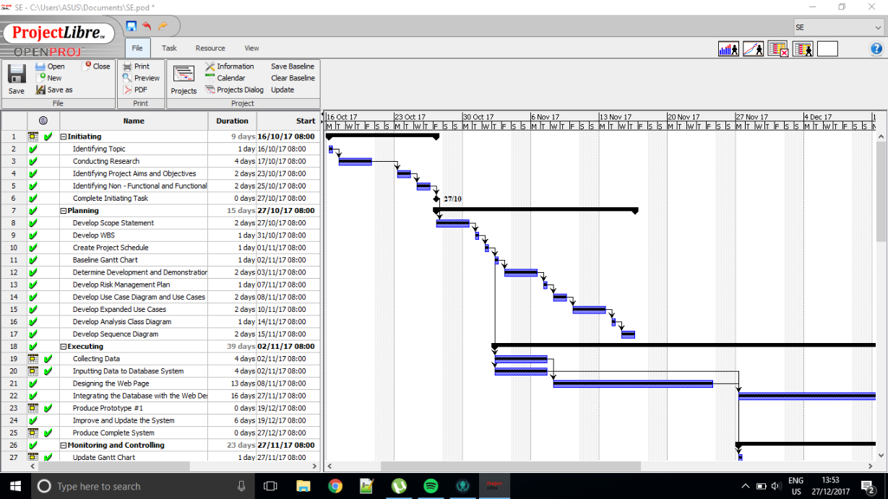

Slide 9
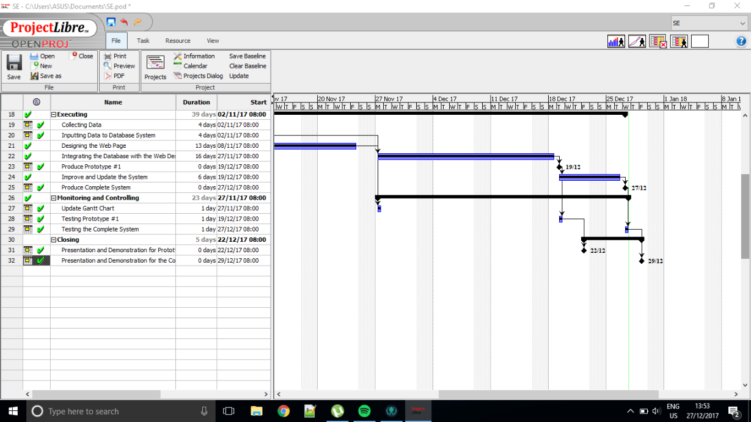

Slide 10
High level design
High level use case
Analysis class diagram
System sequence diagram

Slide 11
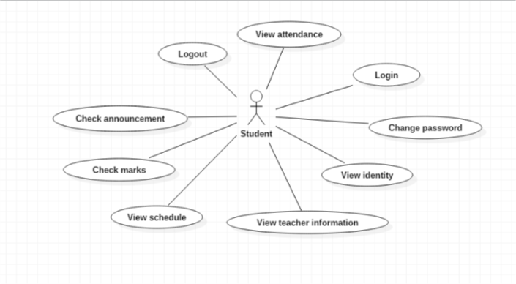

Slide 12
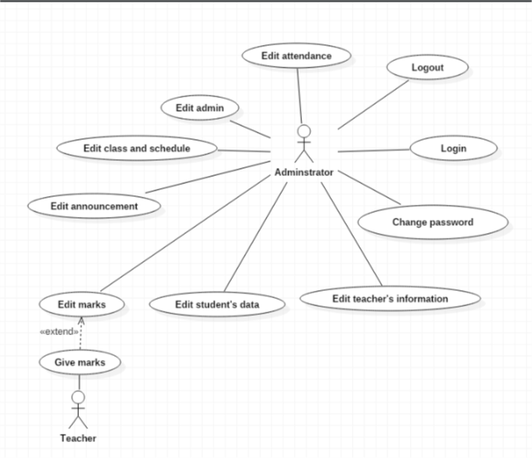

Slide 13
Requirement | Actor | Use Case
Login page has been created and functioned to allow admin and students to log in. | Student Admin | Log in
Student and admin have been registered to the system and have had a login password | Student Admin | Change password
The system provides a page for students to view their personal information and contact details | Student | View identity
The system has a page that shows contact details of all teachers in the school that students can view | Student | View teacher information

Slide 14
Requirement | Actor | Use Case
The system has a page that shows schedule based on the class of the student | Student | View schedule
A page for student to see their marks for home works, monthly tests, middle test, and final exam | Student | Check marks
Announcement that has been posted by admin will appear in student’s home page | Student | Check announcement

Slide 15
Requirement | Actor | Use Case
Teacher has given homework or test to students, and admin will input the marks to the system | Admin Teacher | Edit marks
Students that have enrolled to the school will provide their personal data and contact details, and the information will be recorded in the system by admin | Admin | Edit student’s data
Information about teachers in the school will be recorded in the system by admin | Admin | Edit teacher’s data

Slide 16
Requirement | Actor | Use Case
Form to create announcement and it will be posted to student home page | Admin | Edit announcement
If there is a new class at the beginning of semester, new class and schedule will be created If the class is already existed, the schedule will be updated at the beginning of the semester If the class will no longer be needed, the class and schedule will be deleted at the beginning of the semester | Admin | Edit class and schedule
The system provides form to add or delete admin | Admin | Edit admin
The system provides log out button that will direct admin or student back to the login page | Admin Student | Log out

Slide 17
Requirement | Actor | Use Case
The system has a page that shows monthly attendance | Student | View attendance
The system provides form to edit attendance information of each student | Admin | Edit attendance

Slide 18
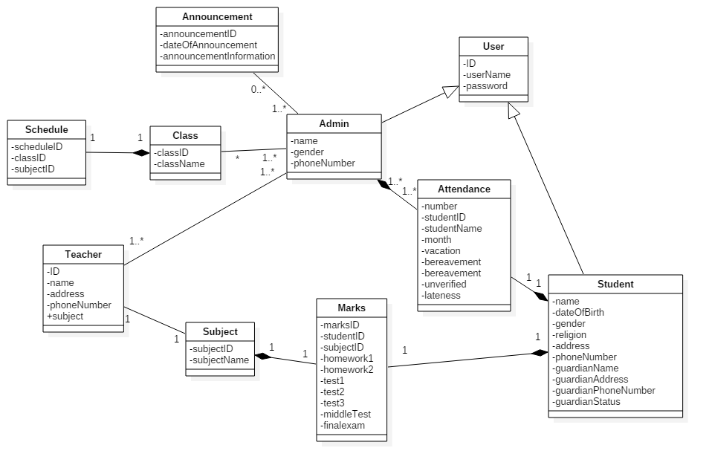

Slide 19
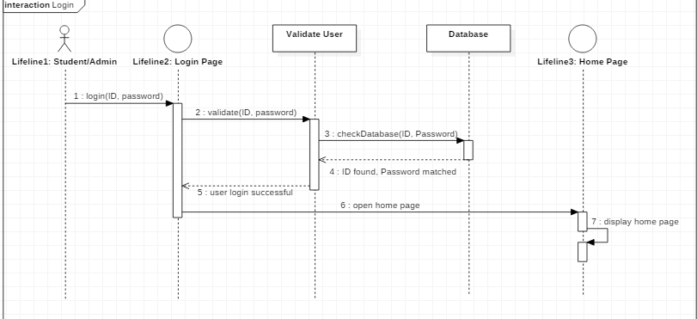

Slide 20
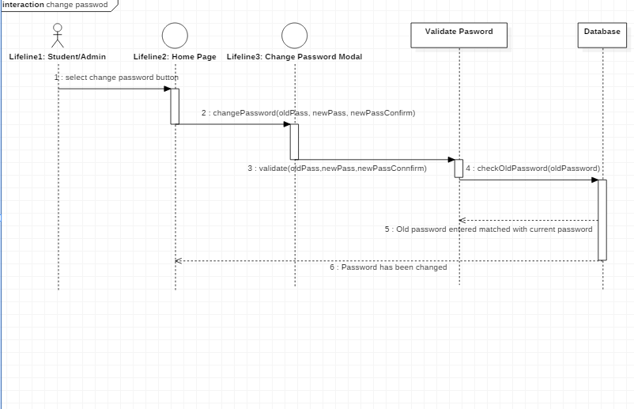

Slide 21
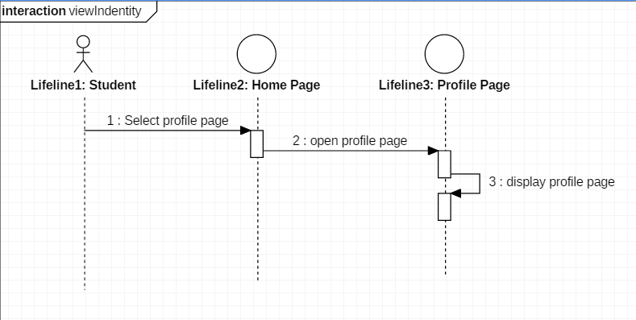

Slide 22
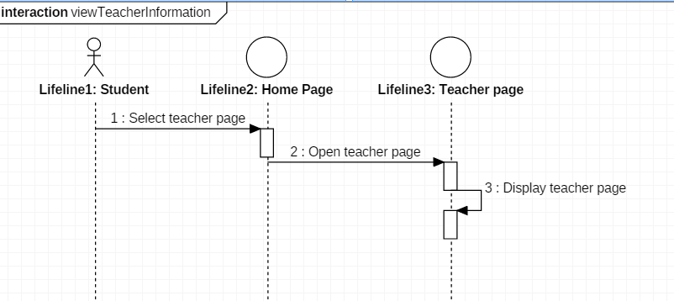

Slide 23
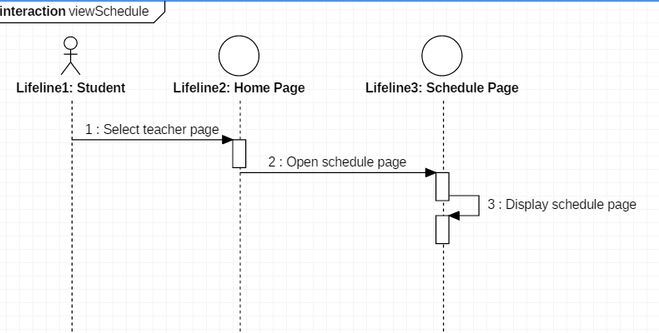

Slide 24
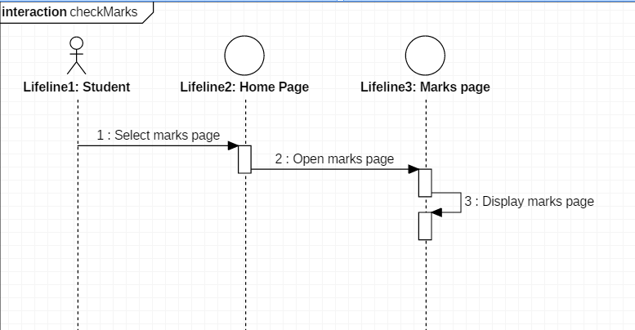

Slide 25
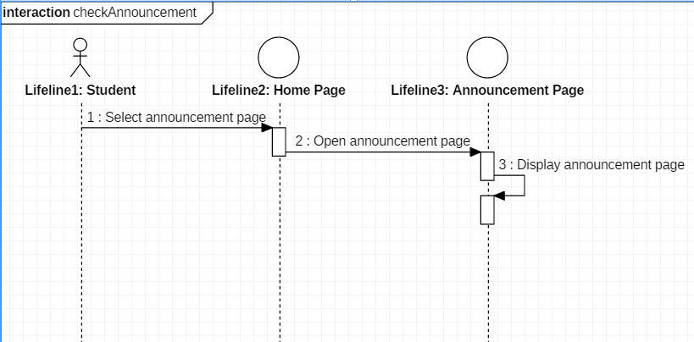

Slide 26
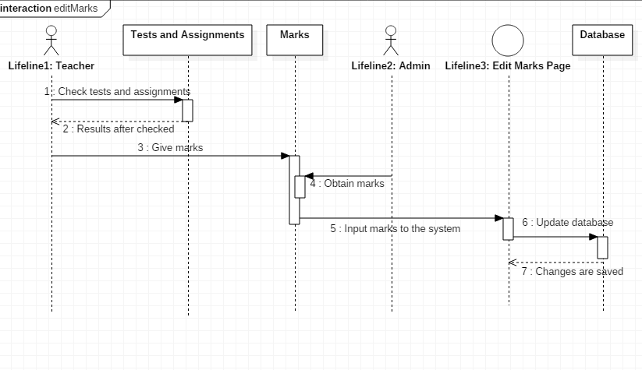

Slide 27
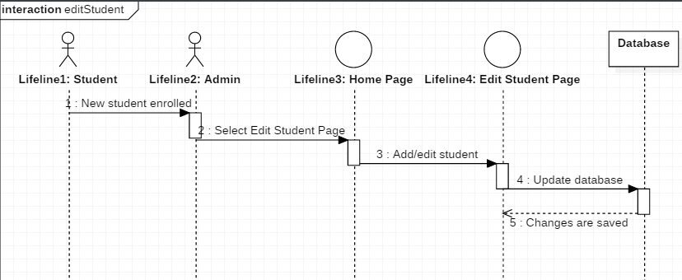

Slide 28
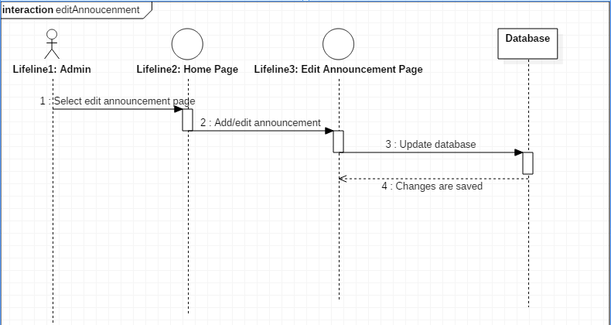

Slide 29
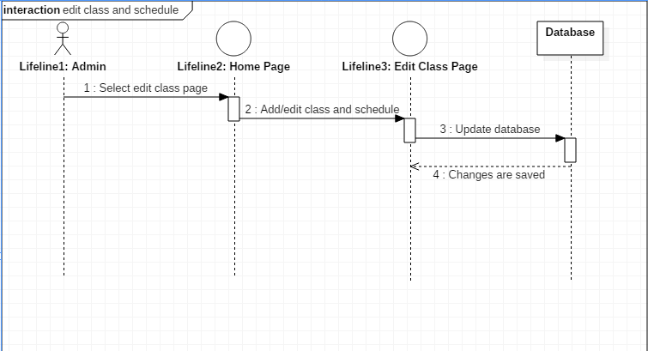

Slide 30
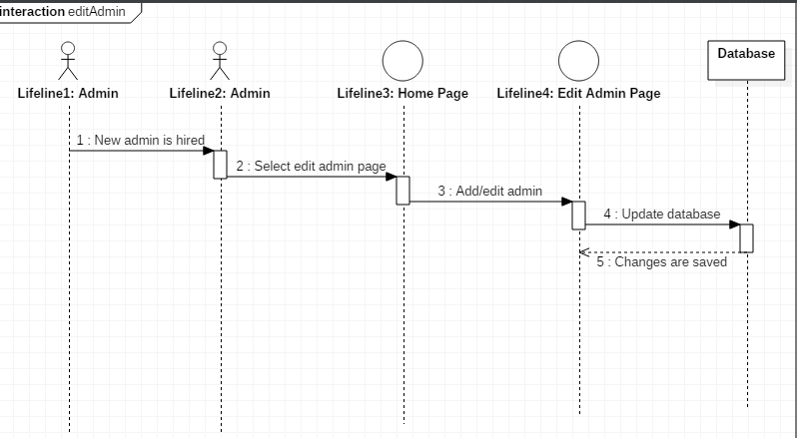

Slide 31
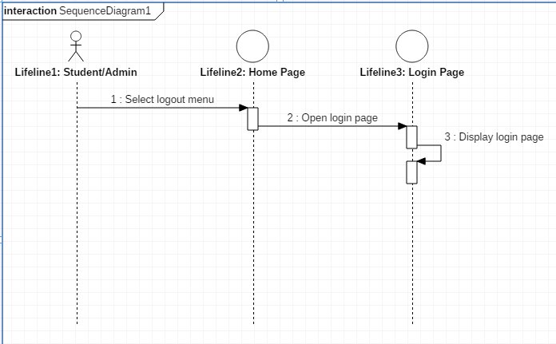
Logout

Slide 32
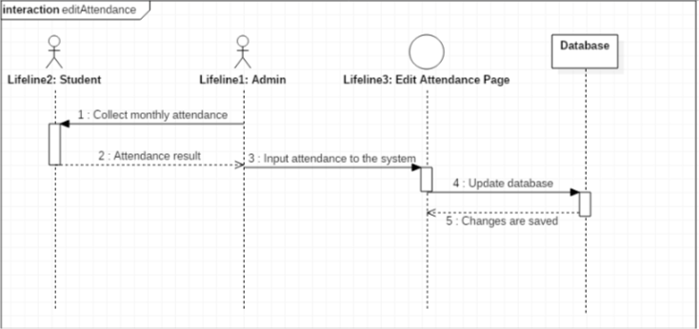

Slide 33
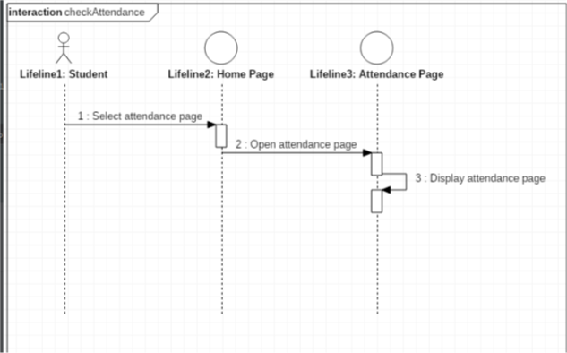

Slide 34
Low level Design
Expanded use case
Class diagram

Slide 35
Log in
Use Case | Log in
Goal in Context | Allow admin and students to access the home page
Primary Actor Secondary Actor | Admin and students -
Typical Course of Events
Actor Actions | System Response
1. The process begins when the student or admin enter their user ID and password, and presses the login button | 2. The system checks the information received
 | 3. The system displays the home page for the registered user or for admin.
Alternative Course
Line 3: If the student or admin entered wrong ID or password, the system will show alert message to tell if the information being entered is incorrect and student or admin should enter their information again.

Slide 36
Change password
Use Case | Change password
Goal in Context | Allow admin and students to change their login password
Primary Actor Secondary Actor | Admin and students -
Typical Course of Events
Actor Actions | System Response
1. The process begins when the student or admin has been logged in
2. Admin or student select the change password menu | 3. The system displays change password page with form to fill in the new password
4. Admin or student has to fill in the form and type in the new password twice as validation
5. Admin or student select the submit button | 6. The system will save the changes and update the database
Alternative Course
Line 3: If two passwords being entered do not match, alert message will be shown and the new password cannot be submitted

Slide 37
View identity
Use Case | View identity
Goal in Context | Allow students to access see their own personal information and contact details
Primary Actor Secondary Actor | Students -
Typical Course of Events
Actor Actions | System Response
Student has already accessed the home page and choose the personal information menu | 2. The system displays the personal information page
Alternative Course
-

Slide 38
View teacher information
Use Case | View teacher information
Goal in Context | Allow students to access teacher information page
Primary Actor Secondary Actor | Students -
Typical Course of Events
Actor Actions | System Response
1. Student has already accessed the home page and choose the teacher information menu | 2. The system displays the teacher information page
Alternative Course
-

Slide 39
View schedule
Use Case | View schedule
Goal in Context | Allow students to access schedule page
Primary Actor Secondary Actor | Students -
Typical Course of Events
Actor Actions | System Response
1. Student has already accessed the home page and choose the schedule menu | 2. The system displays the schedule page
Alternative Course
-

Slide 40
Check marks
Use Case | Check marks
Goal in Context | Allow students to check marks for home works or tests
Primary Actor Secondary Actor | Students -
Typical Course of Events
Actor Actions | System Response
1. Student has already accessed the home page and choose the marks menu | 2. The system displays the marks page
Alternative Course
-

Slide 41
Check announcement
Use Case | Check announcement
Goal in Context | Allow students to check announcement
Primary Actor Secondary Actor | Students -
Typical Course of Events
Actor Actions | System Response
1. Student has already accessed the home page and choose the announcement menu | 2. The system displays the newest announcement posted by admin
Alternative Course
-

Slide 42
Edit marks
Use Case | Edit marks
Goal in Context | Admin can input marks for students or edit the marks
Primary Actor Secondary Actor | Admin Teacher
Typical Course of Events
Actor Actions | System Response
1. Teacher has checked a home work or test of students
2. Admin select to the marks menu in the system | 3. The system displays the marks page
4. Admin add new marks for student based on the subject and the type of the mark (homework or test or exam) | 5. The system saved the changes and update the information that will be displayed in the marks page
Alternative Course
Line 4: Admin can choose to edit existing marks in the system

Slide 43
Edit student’s data
Use Case | Edit student’s data
Goal in Context | Admin can input information of new students or edit information of existing students
Primary Actor Secondary Actor | Admin -
Typical Course of Events
Actor Actions | System Response
1. Admin receives information about new students
2. Admin select to the student menu in the system | 3. The system displays the student page
4. Admin add new student to the database and his/her personal information and contact details | 5. The system saved the changes and update the information that will be displayed in the student page
Alternative Course
Line 1: Admin receive information about existing student that want to change his/her data Line 4: Admin edit the existing student’s data and update the database Line 1: Admin receive information about student that will quit from the school Line 4: Admin delete the student’s data and update the database

Slide 44
Edit teacher’s data
Use Case | Edit teacher’s data
Goal in Context | Admin can input information of new teachers or edit information of existing teachers
Primary Actor Secondary Actor | Admin -
Typical Course of Events
Actor Actions | System Response
1. Admin receives information about new teachers
2. Admin select to the teacher menu in the system | 3. The system displays the teacher page
4. Admin add new teacher to the database and his/her contact details | 5. The system saved the changes and update the information that will be displayed in the teacher page
Alternative Course
Line 1: Admin receive information about existing teacher that want to change his/her data Line 4: Admin edit the existing teacher’s data and update the database Line 1: Admin receive information about teacher that will quit from the school Line 4: Admin delete the teacher’s data and update the database

Slide 45
Edit announcement
Use Case | Edit announcement
Goal in Context | Admin can input new announcement or edit an existing one
Primary Actor Secondary Actor | Admin -
Typical Course of Events
Actor Actions | System Response
1. Admin receives information about new announcement
2. Admin select to the announcement menu in the system | 3. The system displays the announcement page with form that admin can fill in
4. Admin fill in the form and press the submit button | 5. The system will post the announcement to the student home page and admin announcement page
Alternative Course
Line 1: Admin receives information to change some information from announcement that previously has been posted Line 4: Admin delete the existing announcement before fill in the form and create a new one

Slide 46
Edit schedule
Use Case | Edit class and schedule
Goal in Context | Admin can input new schedule at the start of the semester or edit the schedule if there is mistake when adding
Primary Actor Secondary Actor | Admin -
Typical Course of Events
Actor Actions | System Response
1. Admin receives information about new schedule for existing class
2. Admin select to the schedule menu in the system | 3. The system displays the schedule page
4. Admin add new schedule based on the class | 5. The system saved the changes and update the information that will be displayed in the schedule page
Alternative Course
Line 1: Admin receives information that a new class is to be created with its schedule Line 4: Admin add new class and add new schedule based on the new class Line 1: Admin receives information to delete a class and its schedule Line 4: Admin delete the class and its schedule

Slide 47
Edit admin
Use Case | Edit admin
Goal in Context | New admin can be added to the system or delete existing one
Primary Actor Secondary Actor | Admin -
Typical Course of Events
Actor Actions | System Response
1. Existing admin receives information about new admin
2. Admin select the add admin menu in the system | 3. The system displays the new admin page
4. Admin add new admin to the database and his/her ID and password | 5. The system saved the changes and update the information that will be displayed in the existing admin page
Alternative Course
Line 1: Admin receive information about admin that will quit from the school Line 4: Admin delete the admin’s data and update the database

Slide 48
Log out
Use Case | Log out
Goal in Context | Allow admin and students to exit the home page
Primary Actor Secondary Actor | Admin and students -
Typical Course of Events
Actor Actions | System Response
1. The process begins when the student or admin have finished what they need to do with the system
2. Student or admin select the log out button | 3. The system displays login page
Alternative Course
-

Slide 49
Edit attendance
Use Case | Edit attendance
Goal in Context | Admin can input monthly attendance information for each student
Primary Actor Secondary Actor | Admin -
Typical Course of Events
Actor Actions | System Response
1. Admin receives information about student monthly attendance
2. Admin select the attendance menu in the system | 3. The system displays the edit attendance page
4. Admin add new attendance information which includes student name, duration of absence and month | 5. The system saved the changes and update the information that will be displayed in the attendance page
Alternative Course
-

Slide 50
View attendance
Use Case | View attendance
Goal in Context | Allow students to check their own monthly attendance
Primary Actor Secondary Actor | Students -
Typical Course of Events
Actor Actions | System Response
1. Student has already accessed the home page and choose the attendance menu | 2. The system displays the attendance page
Alternative Course
-

Slide 51
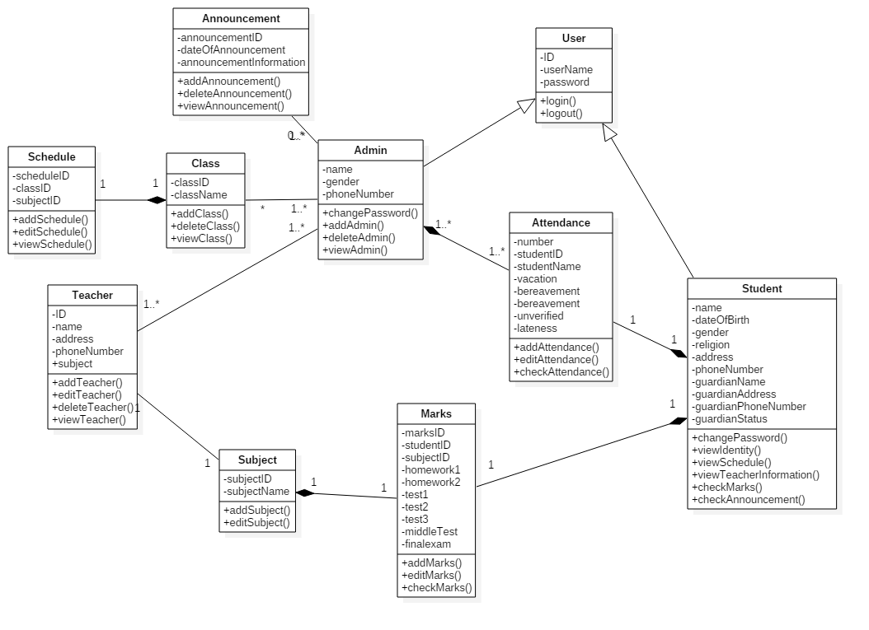

Slide 52
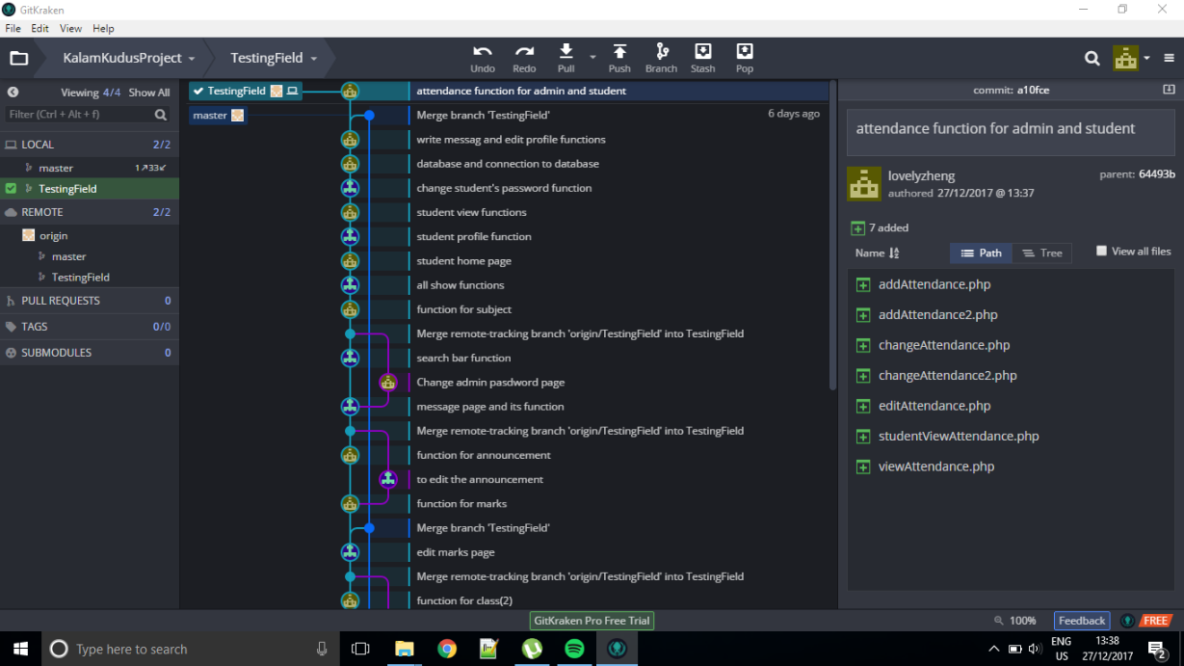

Slide 53
